Slide 1
Reconstruction For Rendering distribution Effect
Song Hyunji
2016.6.9

Slide 2
First Paper
“Temporal light field reconstruction for rendering distribution effects”
  ACM Transactions on Graphics 2011
  Jaakko Lehtinen et al.
  Distribution effects are like motion blur, depth of field

Slide 3
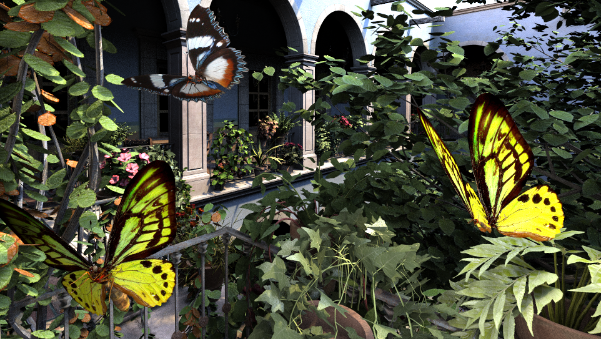
Pinhole image
The image that is rendered using a pinhole camera model looks sharp.
Not realistic

Slide 4
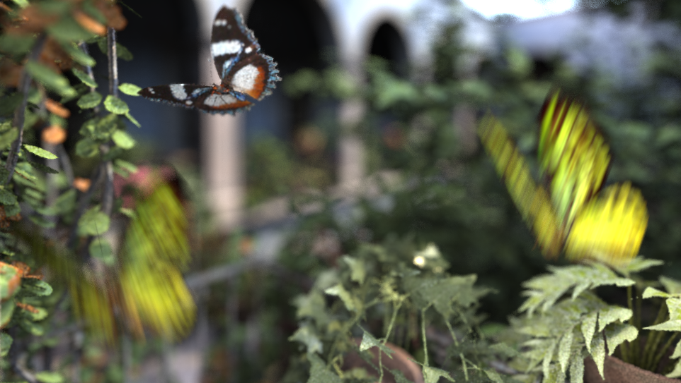
With motion blur and depth of field
Distribution effects can increase the realism of image.
The traditional method for rendering these phenomena is to take many samples per pixel
Requires dense sampling of 5D function:
Pixel area (2D)
Lens aperture (2D)
Time (1D)

Slide 5
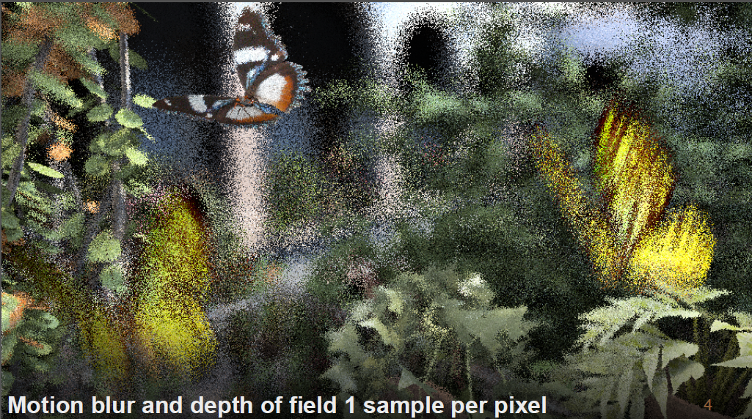
Motion blur and depth of field 1 sample per pixel

Slide 6
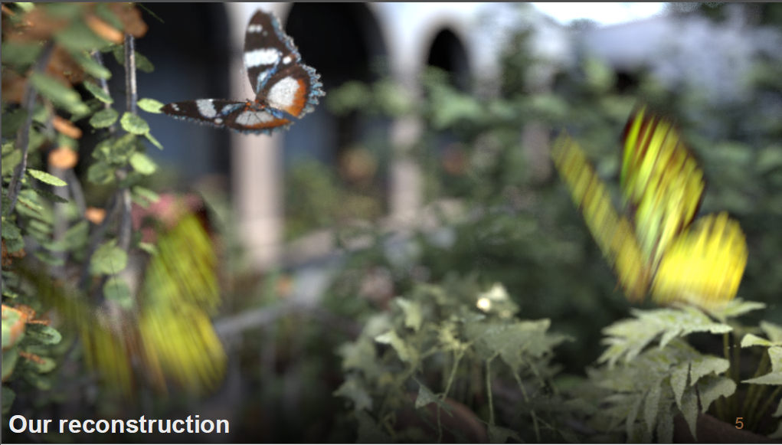
Proposed algorithm

Slide 7


Pinhole camera model
background
object
lens
sensor

Slide 8
Thin lens camera model
background
object
lens
sensor

Slide 9
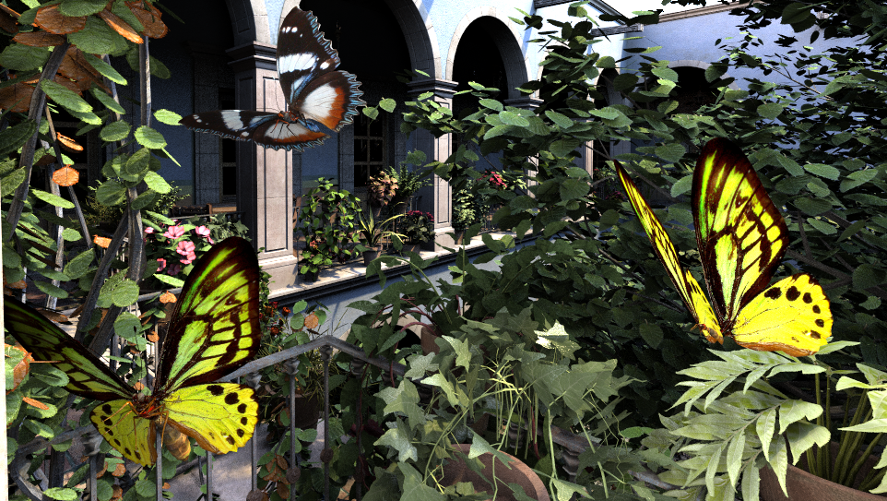
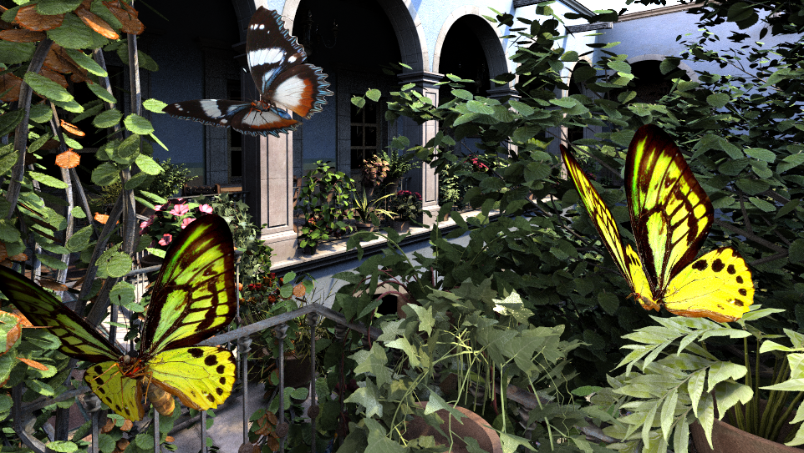

Thin lens camera model

Slide 10
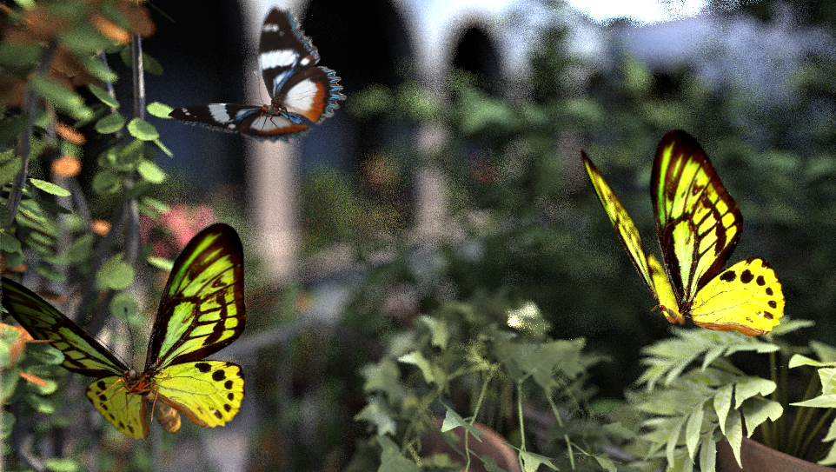
Averaging these pinhole images

Slide 11

Proposed approach
1. Generate x(screen),u(Lens) diagram
Lens u
Output:
integration over lens
Screen x
Author’s slide

Slide 12
Proposed approach
2. Start with sparse input sampling
Lens u
Screen x
Author’s slide

Slide 13
Proposed approach
2. Use slope to reproject radiance
  input samples come equipped with radiance and a slope
Lens u
Screen x
Author’s slide

Slide 14
Proposed approach
2. Use slope to reproject radiance
Lens u
Screen x

Slide 15

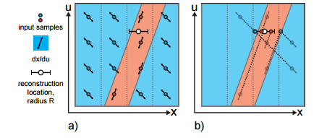

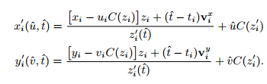
Reprojection
X,y: screen coordinate
uv,: lens coordinate
Z: depth
V: 3D motion vector
L: radiance
Input sample parameters: 5D
Reprojection equation
z’,x’,y’: reprojected location

Slide 16
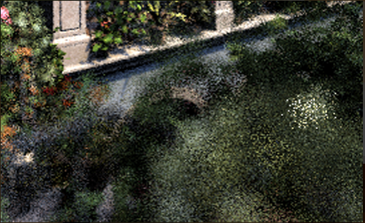
Reprojection
Lens u
1 pixel
Screen x

Slide 17
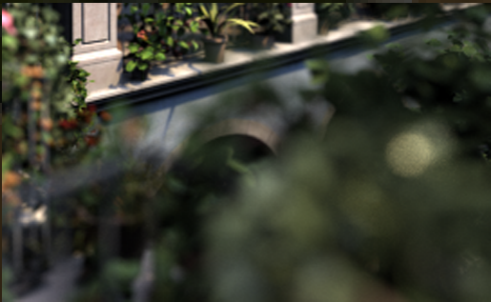
Proposed approach
Perform dense reconstruction using sparse input samples
Averaging reprojected radiance in 1 pixel-> output
Lens u
1 pixel
Screen x

Slide 18
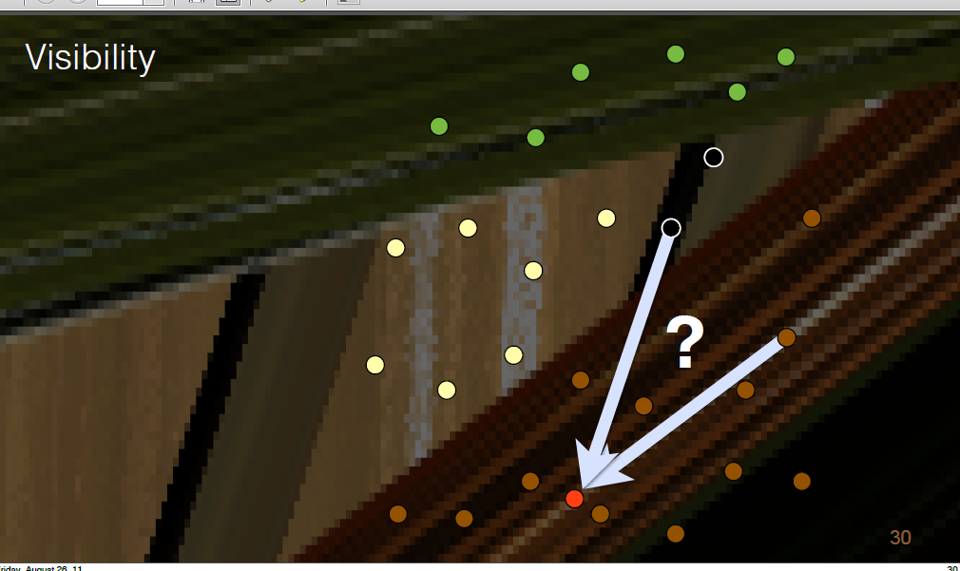
Reconstruction with complex visibility
Two samples can be reproject to the same red location
In this case, we have to account for occlusion
Author’s slide

Slide 19
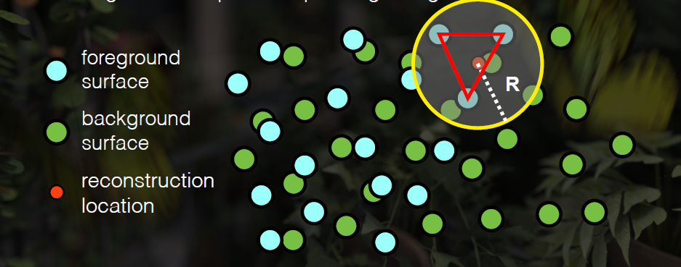
Reconstruction with complex visibility
Determine coverage in the case of two overlapping apparent surfaces
Author’s slide

Slide 20
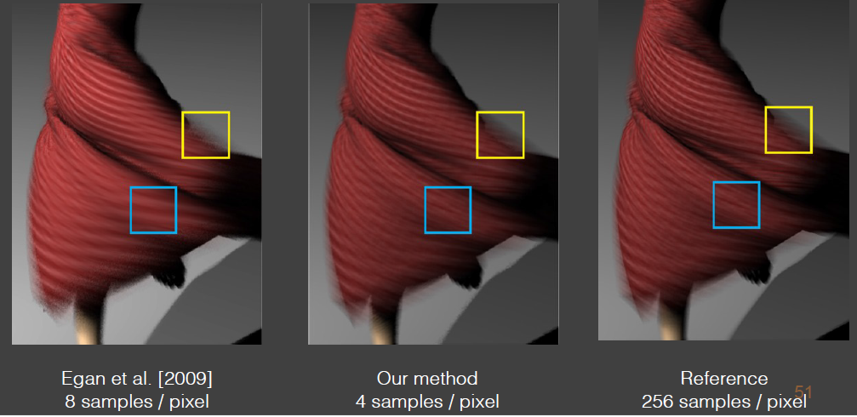
Result & Comparison

Slide 21
Second Paper
“Reconstructing the indirect light field for global illumination”
  ACM Transactions on Graphics 2012
  Jaakko Lehtinen et al.

Slide 22
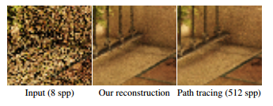
Indirect light field
Stochastic techniques for rendering indirect illumination suffer from noise due to the variance in the intergration.

Slide 23

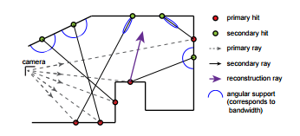
Input & Output
The radiance L from point p towards the camera c is computed by
Each input samples corresponds to a secondary ray, and consists of the tuple

Slide 24

Input & Output
Output
  Given the samples recorded in the first pass, the second pass evaluates for each primary hit in the input samples.
  The reconstruct function performs the upsampling of the incident light field based on the input samples
And, How to calculate RECONSTRUCT(p,w)?
Notes:
on the input samples

Slide 25
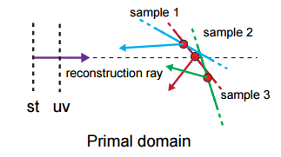
Reconstruction
Find intersection point between reconstruction ray and spatial support of samples.
Take a weighted average among all samples.
intersection

Slide 26
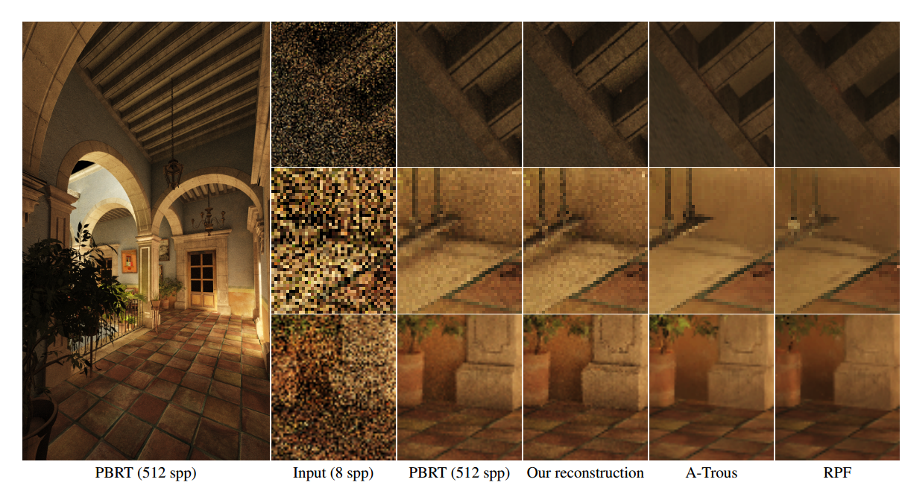
Result

Slide 27
Thank you

Slide 28
Quiz
1. With a pinhole camera, a single pixel can receive light from many different parts of the scene, and we get a blurry background. (T/F)
2. In second paper, the function RECONSTRUCT(p,w) performs the upsampling of the incident light field based on the input samples. (T/f)

